Slide 1
Standard Template Library

Slide 2
Parts of a Computer program
Data Structure:
It refers to the way how data is stored in the memory.
Algorithms:
It refers to the way how the stored data is manipulated.

Slide 3
Standard Template Library
Container Class Libraries:
Libraries offered by the compiler to handle the storage and processing of data.
Standard Template Library:
C++ have its own container class library called as Standard Template Library.
Developed by Alexander Stepanov and Meng Lee of Hewlett Packard.

Slide 4
Entities of STL
Container:
It is a collection of objects for storing data. It’s a way how the stored data is organized in library. Eg : Stacks, Arrays. The STL containers are implemented by template classes, so they can be easily customized to hold different kinds of data.
Algorithms:
These are the procedures that are applied to containers to process their data in various ways. Eg: Sorting, copy. Algorithms are represented by template functions. These functions are not member functions of the container classes. Rather, they are standalone functions

Slide 5
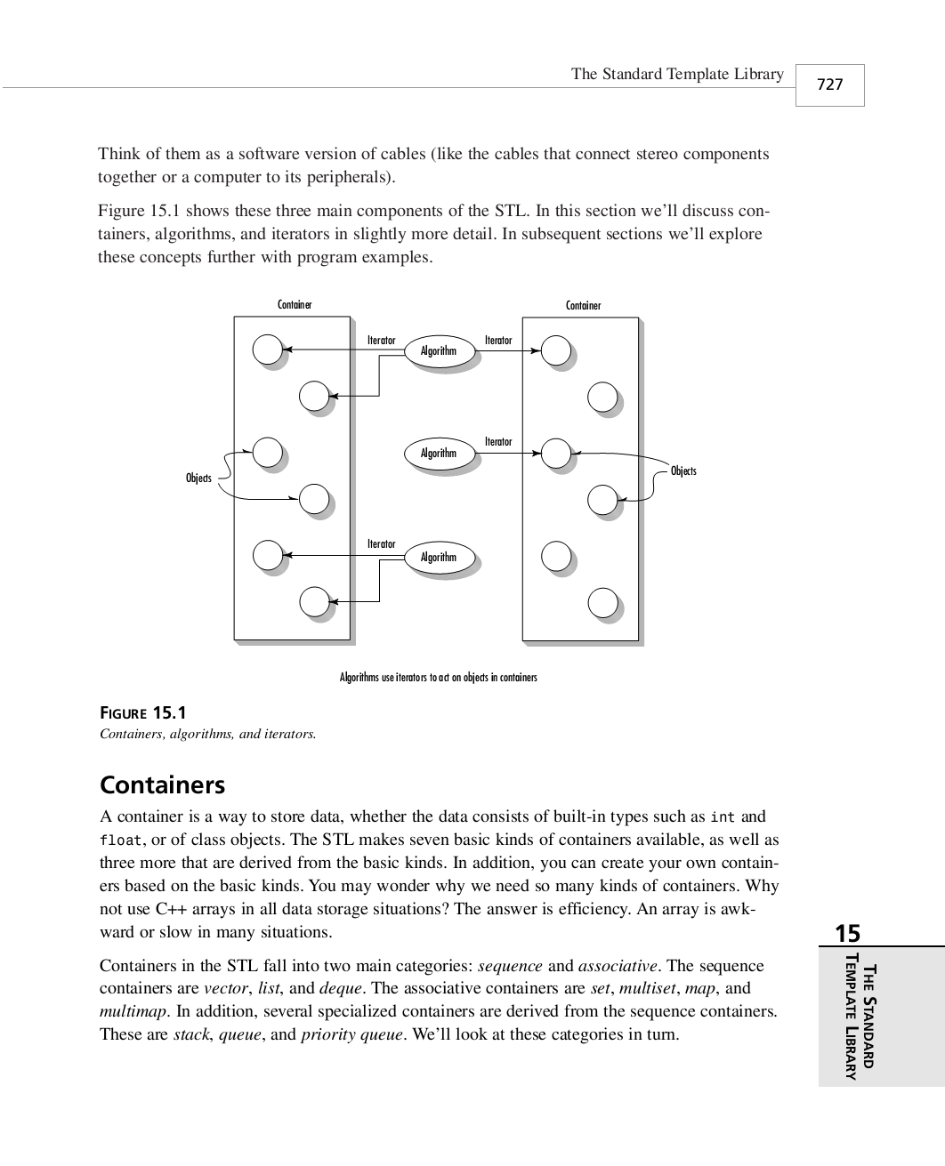
Entities of STL
Iterators:
They point to elements in a container. They are the generalization of the concept of pointers. Iterators are a key part of the STL because they connect algorithms with containers.

Slide 6
Containers
A container is a way to store data, whether the data consists of built-in types such as int and float,or of class objects. The STL makes seven basic kinds of containers available, as well as three more that are derived from the basic kinds.
Containers in the STL fall into two main categories: sequence and associative.
The sequence containers are : vector, list, and deque.
The associative containers are set, multiset, map, and multimap.
Several specialized containers are derived from the sequence containers. These are stack, queue, and priority queue

Slide 7
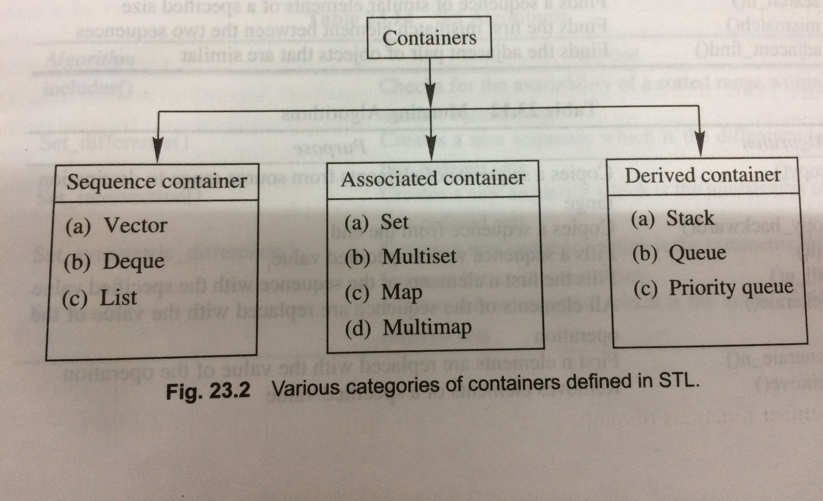
Various Categories of Containers

Slide 8
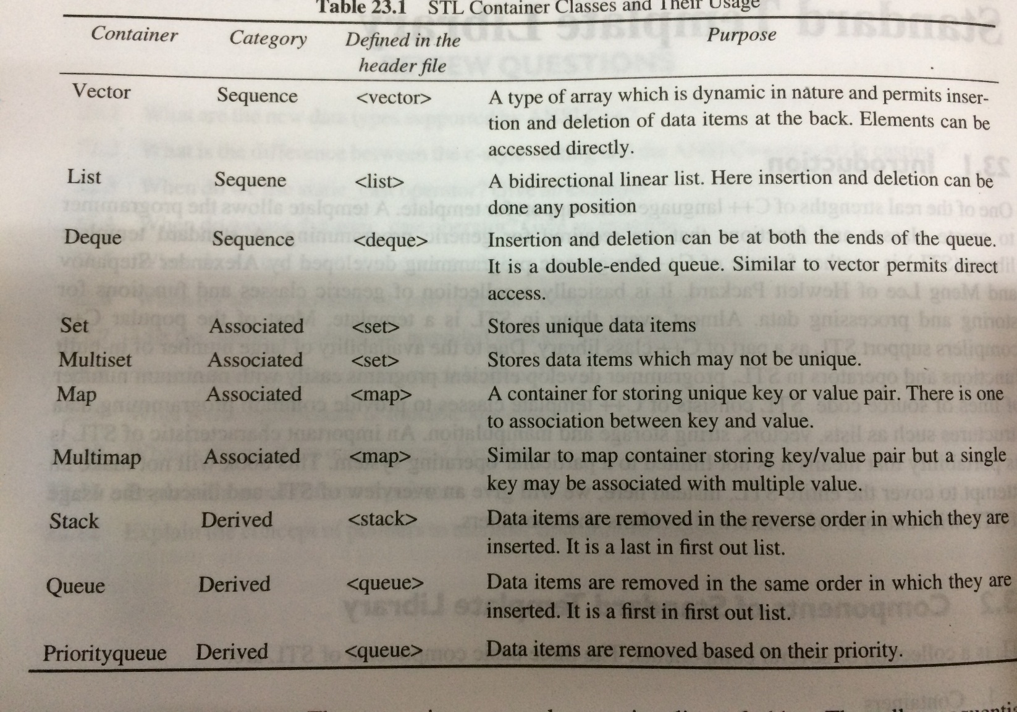
STL Container Classes and their Usage

Slide 9
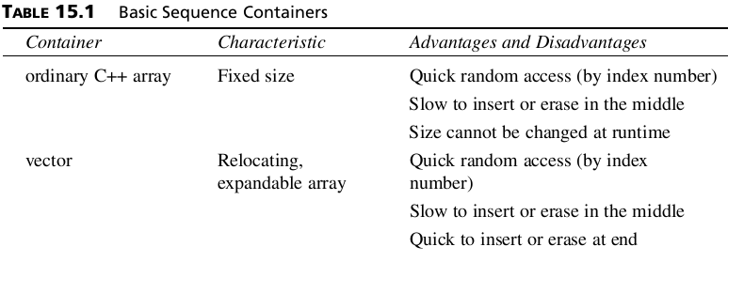
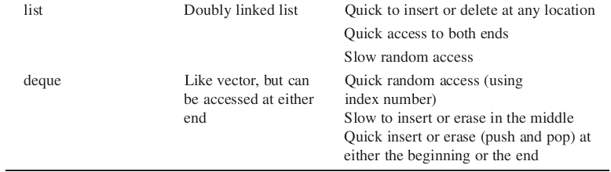
Sequence Containers
A sequence container stores a set of elements. Each element (except at the ends) is preceded by one specific element and followed by another. An ordinary C++ array is an example of a sequence container.

Slide 10
Sequence Containers
Initializing container object :
First you must include an appropriate header file.
Then you use the template format with the kind of objects to be stored as the parameter.
Example:
There’s no need to specify the size of STL containers. The containers themselves take care of all memory allocation.
vector<int> aVect; //create a vector of ints
or
list<airtime> departure_list; //create a list of airtimes

Slide 11
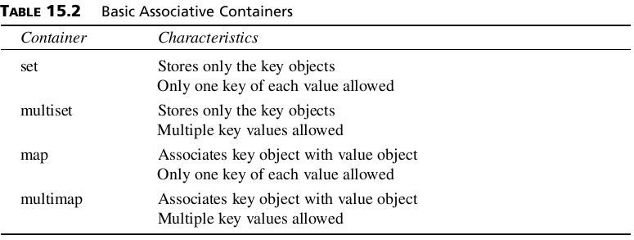
Associative Containers
An associative container is not sequential; instead it uses keys to access data. The keys, typically numbers or stings, are used automatically by the container to arrange the stored elements in a specific order.

Slide 12
Associative Containers
Creating associative containers is just like creating sequential ones:
set<int> intSet; //create a set of ints
or
multiset<employee> machinists; //create a multiset of employees

Slide 13
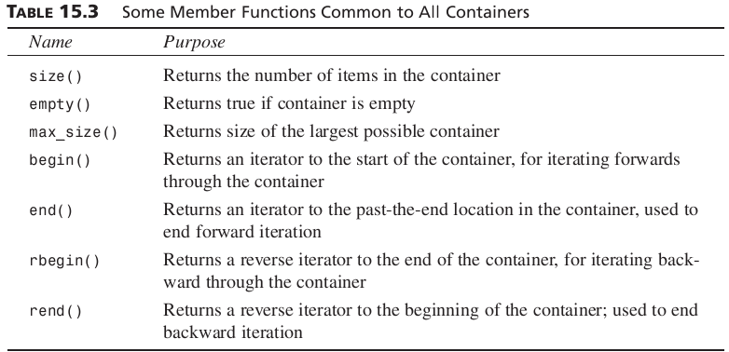
Member Functions
Algorithms are the heavy hitters of the STL, carrying out complex operations like sorting and searching. However, containers also need member functions to perform simpler tasks that are specific to a particular type of container.

Slide 14
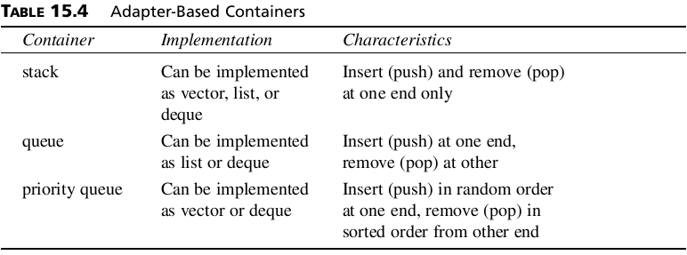
Container Adapters/Derived Containers
It’s possible to create special-purpose containers from the normal containers mentioned previously using a construct called container adapters.
These special-purpose containers have simpler interfaces than the more general containers.
The specialized containers implemented with container adapters in the STL are stacks, queues, and priority queues.

Slide 15
Algorithms
An algorithm is a function that does something to the items in a container (or containers).
Algorithms in the STL are not member functions or even friends of container classes, as they are in earlier container libraries, but are standalone template functions.
Suppose you create an array of type int,with data in it:
int arr[8] = {42, 31, 7, 80, 2, 26, 19, 75};
You can then use the STL sort()algorithm to sort this array by saying
sort(arr, arr+8);
Where arr is the address of the beginning of the array, and arr+8is the past-the-end address
(one item past the end of the array).

Slide 16
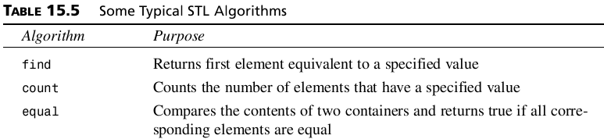
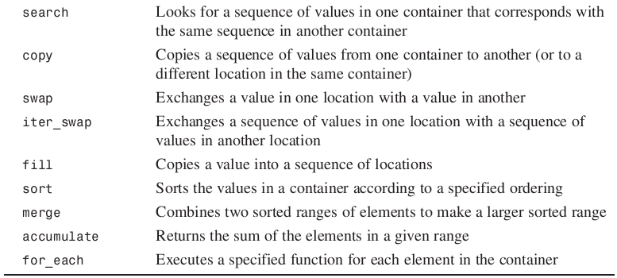
Algorithms

Slide 17
Iterators
Iterators are pointer-like entities that are used to access individual data items (which are usually called elements), in a container.
Often they are used to move sequentially from element to element, a process called iterating through the container.
Different classes of iterators must be used with different types of container. There are three major classes of iterators: forward, bidirectional, and random access.

Slide 18


